Slide 1
Adapting to Climate Change
CDOIF v.Jan 2024
Understanding the risks of a changing climate, and managing them safely
Developed in collaboration through CDOIF Natech and Climate Change Adaptation working group

Slide 2
Contents
Section1: Natech risk management and climate change adaptation
What is a Natech?
How does climate change impact safety and environmental protection?
What is the priority for action?
What is the difference between adaptation and mitigation?
How can risks be managed safely?
How can uncertainty be managed?
What do regulators expect to see?
Where can I get further information?
Section 2: A closer look at the major hazard management system cycle
Major hazard management systems
Section 3 Natech case studies
Pt.1 – Accidents that have occurred
Pt.2 – Lessons learned
Note:
These slides contain 3 sections and not all slides suit all audiences
Section 1 provides an introductory overview, suitable for all levels of management
Section 2 provides detail on how adaptation can be embedded into management systems, for management system leads
Section 3 provides a general reference resource of case studies and further information which can be referred to where relevant to a specific installation

Slide 3
Natech risk management and climate change adaptation
Section 1
Developed in collaboration through CDOIF Natech and Climate Change Adaptation working group

Slide 4
What is a Natech?
Natural Hazard Triggered Technological Accident (Natech)
Industrial accidents with natural causes, such as flooding, storms, lightning, high/low temperatures, sea level rise, subsidence, wildfire etc.
Natechs can degrade protection measures, causing harm to people and the environment … and assets/businesses/supply chains
Common Natech characteristics
Wide area impact – both local impacts and wider area disruption (such as power and communications outages, supply chain disruption, cascading risks)
Common cause failures across barriers
Impact on preventive and mitigatory measures – including emergency responders
Potential for multiple simultaneous major accidents
Multiple, simultaneous failures & releases
Existing control measures (barriers and systems) not designed for present day and future environmental extremes – the climate has already changed
(e.g. East Coast surge)
Planning for Natechs is essential for process safety

Slide 5
What are the most common extreme weather/ Natech threats at present?
G.B.
Natech accidents reported by 5 EU countries (1990-2009) MAHB, Lessons Learned Bulletin No.6 – NaTech accidents, 2014
Extreme weather threats to GB establishments (Survey by CDOIF, 2021)

Slide 6
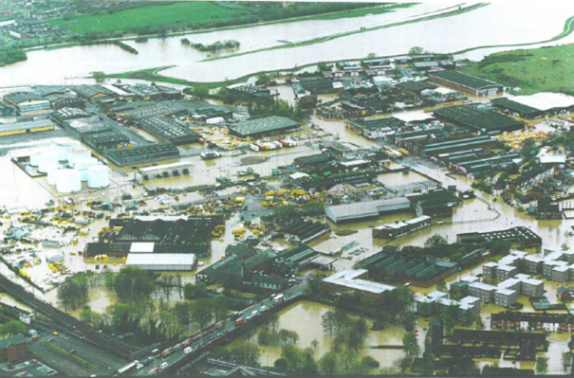
What does a Natech look like?
It could be horrific….
Dronka, Egypt, 1994
  Military fuel depot storing gasoline and jet fuel
  Severe storm resulted in infrastructure damage at and around the installation
  Burning fuel, ignited by lightning, spread through a village on flood waters
  >400 people killed
  There was no secondary containment in place to contain the release – if well designed bunding and good drainage systems had been in place, the burning fuel may have been contained on the site without spreading the fire
  Land use planning aspects – the fuel depot was located close to a village… too close?
  Was this Natech risk even recognised?
Northampton, 1998
A UK wakeup call?
Aidan Whitfield (2003) Assessing and reducing flood risks on Major Hazard sites – IChemE Hazards Archive (XVII)

Slide 7
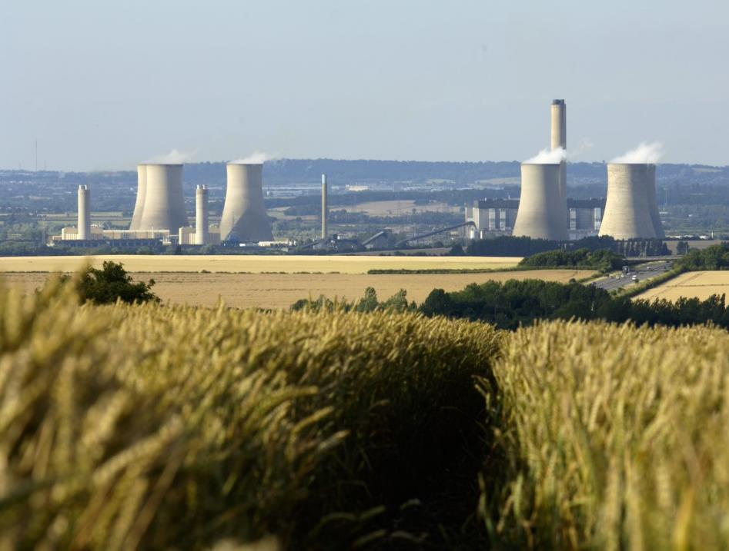
Climate impacts can increase risk of permit non-compliance and impact operations…
High ambient temperatures can impact industrial plant and cooling systems either directly due to the temperature increase or lack of cooling water, or other impacts such as increased risk of biofouling
This can:
threaten the ability to maintain operations within permit limits (e.g. cooling water temperature discharge limit)
reduce the generating efficiency or throughput of the plant itself
necessitate shutdown for safety
Such an event occurred in Europe in 2018/19, resulting in nuclear plant power output reduction or outage
See Natech case studies which include further heatwave impact examples

Slide 8
How does climate change impact safety and environmental protection?
Frequency and severity of events
Control measure failure or degradation
Due to increasing risk of natural causes, there is an increased risk of control measures failing or degrading, increased risk of supply chain/utility disruption and thus an overall increasing risk of accidents or other non-compliance events [if risks are unmanaged]
Climate change has increased the frequency and severity of extreme weather events and is causing other impacts such as sea level rise and increased receptor vulnerability
Receptor vulnerability
Climate change impacts are making receptors more vulnerable to harm from accidents, which can increase the severity of impact from pollution

Slide 9
The influence of climate change on the risk of industrial accidents or other non-compliance
“Natech risk is expected to increase in the future” JRC (2022)
Accident or non-compliance Risk
Time
Climate change will result in increased risk of accidents, if implications for safety and environmental protection are not managed – we need to adapt to control risks

Slide 10
What is the priority for action?
The present
“Climate change is happening now. It is one of the biggest challenges of our generation and has already begun to cause irreversible damage to our planet and way of life.”
The future
“Many of the risks facing the UK are likely to increase both in magnitude and frequency as a result of climate change, and risk assessment cannot be conducted without acknowledging this fact.
UK Climate Change Risk Assessment 2022
Climate change is an ever more significant risk facing the UK and action to address it needs to be undertaken rapidly and as a priority.”
“Preparing for Extreme Risks: Building a Resilient Society”
House of Lords 2021

Slide 11
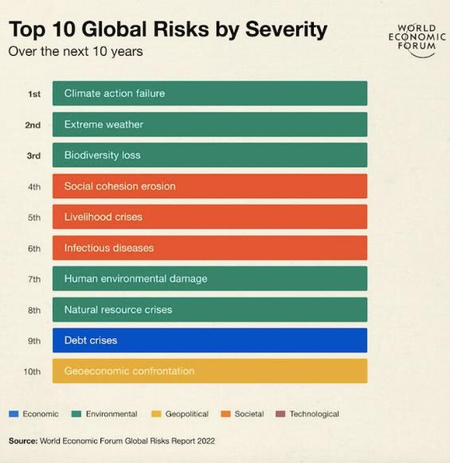
What’s the priority for action?
The World Economic Forum rated climate mitigation and adaptation as the top global risk in 2022
With extreme weather the second highest risk

Slide 12
What is the difference between adaptation and mitigation?
Climate change mitigation
A human intervention to reduce the sources or enhance the sinks of greenhouse gases (GHGs).
Driving the net zero agenda, the need for decarbonisation of energy systems, greater efficiencies and circular economies.
Climate change adaptation
The process of adjustment to actual or expected climate and its effects.
In some natural systems, human intervention can facilitate adjustment to expected climate and its effects.
In human systems, adaptation seeks to moderate or avoid harm or exploit beneficial opportunities.

Slide 13
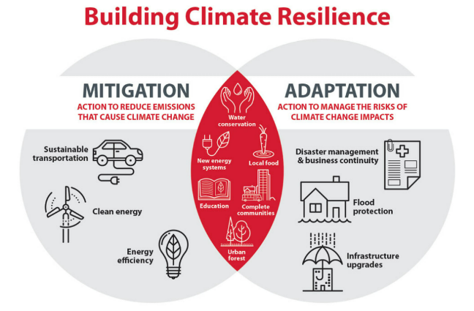
Resilient net zero = mitigation + adaptation
Climate mitigation, resource efficiency and adaptation sometimes seen as separate issues
Encourage ‘integration’ or ‘systems thinking’
Consider climate impacts in short, medium and long term on compliance, including during transition to net zero

Slide 14
How can risks be managed safely?
Ensuring Natech and climate change risk management and decision making is embedded across the whole business management system – bringing resilience benefits, beyond environmental protection and safety, and avoiding wider costs of climate impacts.
Applying process safety leadership and environmental management principles, especially management of change, to events/scenarios with natural causes.
By understanding how risks may change in the future and taking the necessary measures, at an appropriate time, to ensure risks remain ALARP and permit compliance is maintained.

Slide 15
How can uncertainty be managed?
Adaptive management - description
Adaptive management - implementation
Implement adaptive management approaches within management systems – considering various possible climate scenarios, then iteration and continual improvement
The process of iteratively planning, implementing and modifying strategies for managing resources in the face of uncertainty and change
Management systems
Climate adaptation is a ‘thread’ which runs throughout management systems
i.e. Plan-Do-Check-Act cycle to deliver continuous improvement
Commitment to adapt
Keep risk assessments up to date with the best current knowledge of present + future projected climate conditions
Consider risk reduction measures and develop an improvement plan
Monitor Natech relevant information & performance indicators
Periodic review and revision of risk assessments, improvement plans and adequacy of the management system

Slide 16
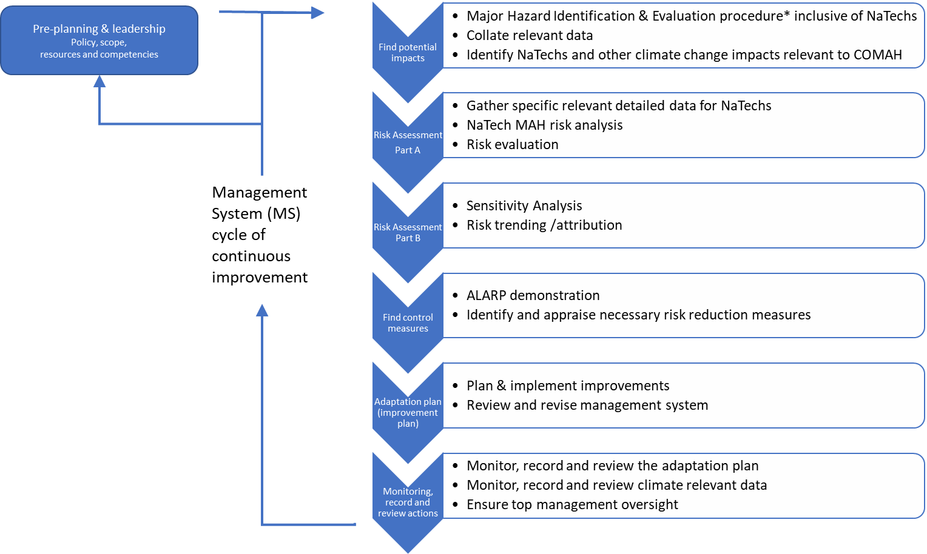
How can uncertainty be managed?

Slide 17
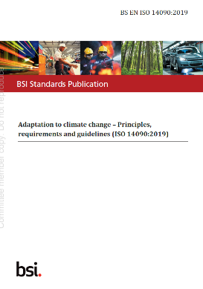
How can uncertainty be managed?
Implement best practice, including:
  ISO 14090 (adaptation to climate change)
  ISO 14091 (assessing climate risks)
  BS 8631 (adaptation pathways)
Gather current data and understanding of future weather projections (e.g. Met Office UKCP18) and other climate change impacts to inform risk management
Continual improvement in adaptation
Plan
Do
Check
Act

Slide 18
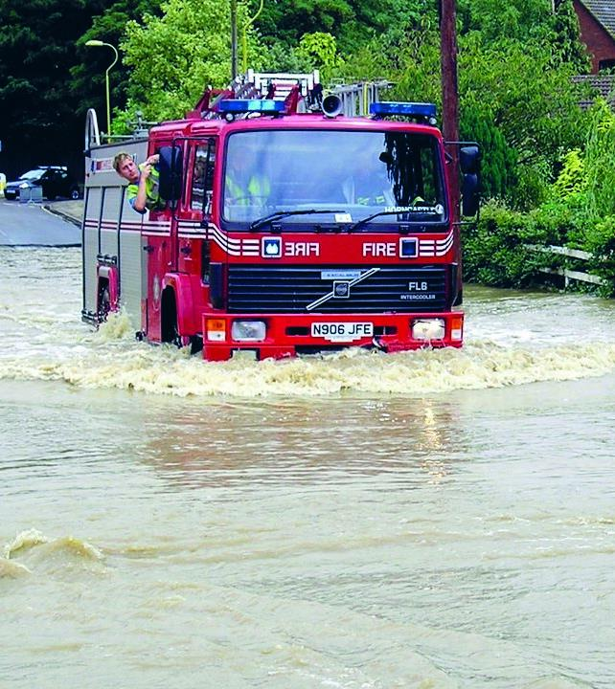
Getting started….
…..ask yourself:
Does your organisation have the leadership, systems, resources and competencies required to manage climate relevant risks and opportunities?
    See ISO 14090, Clause 5
Have you assessed the safety and environmental risks to your business, exploring how it might be vulnerable to the range of climate impacts predicted by Met Office to occur under a 4°C global warming scenario? This is sometimes called ‘stress testing’ the organisation to possible climate impacts
    See ISO 14090, Clause 6 and ISO 14091
Have you exercised your emergency plans to see how they would cope with various extreme weather accident scenarios?
    This could be a joint multi-agency test to explore off-site vulnerabilities

Slide 19
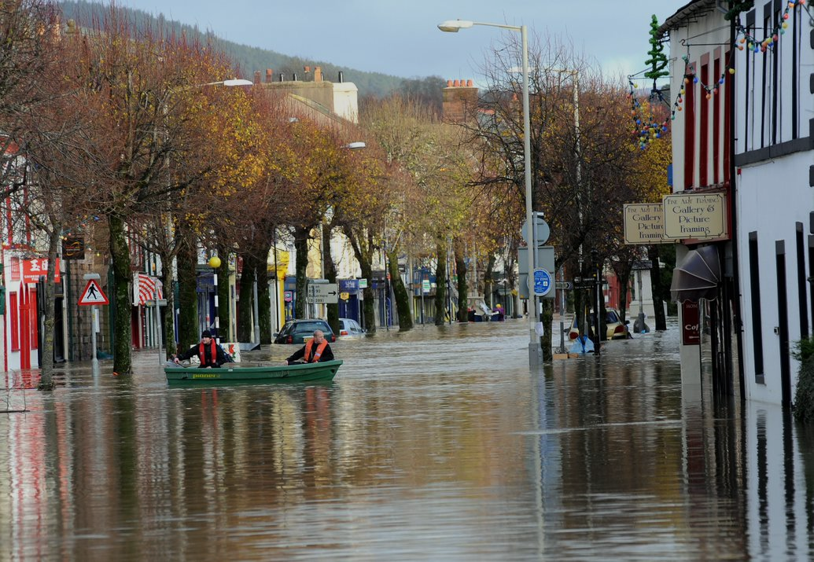
“Our thinking needs to change faster than the climate”
Notes:
Quote on slide from Emma Howard Boyd – May 2019
Business as usual is not an option

Slide 20
Climate science – future projections based on differing emissions scenarios/pathways
Predicted global warming ….
…for different Representative Concentration Pathways (RCPs)….
…..and Shared Socioeconomic Pathways (SSPs)
By 2100 warming could reach 4°C
The climate has already changed
By 2050 a 2 °C rise
is credible
Change in global temp
c.f. pre-industrial baseline

Slide 21
What do regulators expect to see?
Manage risks of a changing climate
Regulators expect operators to manage risks of a changing climate, to maintain compliance with relevant environmental and safety legislation
e.g. The operator of a COMAH establishment would be expected to:
- assess how major accident risks associated with extreme weather events and other climate change impacts will vary over the lifetime of their establishment
Integration of adaptive management techniques
Regulators expect integration of adaptive management techniques within environmental and safety management systems – i.e. embedding adaptation
- plan how to respond to these changes, and implement modifications at an appropriate time, to manage both present and longer-term risk to ALARP levels
And at nuclear sites we have developed a Position Statement on the regulator’s expectations for Use of UK Climate Projections 2018 (UKCP18) by the GB Nuclear Industry

Slide 22
Operators will
What will regulators expect to see?
Understand and manage present day risks (potential extremes, including historic data baseline, e.g. Met Office extremes and state of the climate reports and any available allowances, e.g. flood)
Assess the risks associated with a 4°C rise by 2100 (identify/screen potential impacts to the facility – stress testing)
Plan to manage the risks associated with a 2°C rise by 2050, without creating obstacles for future adaptation - avoiding lock-in
at an appropriate time, adopt measures to maintain compliance and maintain risks As Low As Reasonably Practicable
Monitor, review and revise in subsequent years (establish indicators, validate assumptions, review and revise assessments and plans as new data becomes available)
Use UK climate projections UKCP18* to inform local impacts to regulated sites
Derived projections - include projections at a global mean warming of 2°C and 4°C
*or equivalent data when superseded
More detailed and/or longer timescale assessment and planning may be required for higher risk/higher vulnerability installations (e.g. expanding assessments to include a wider set of RCP data, incl. H++ scenario).
Less detail may be acceptable for short life installations or where there is low risk/climate impacts are not significant for compliance and safety.
Met Office (2022)

Slide 23
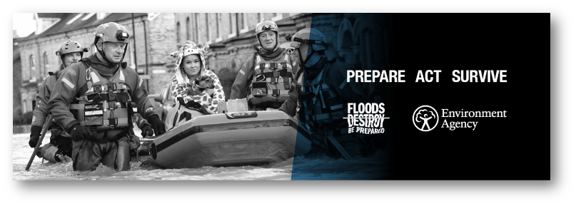
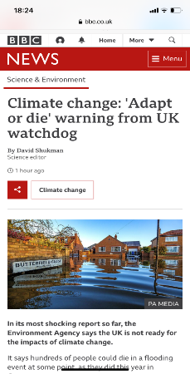
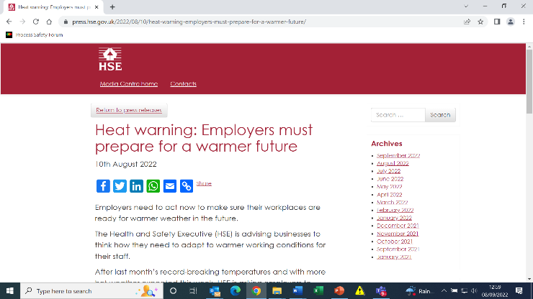
Where can I get more information?
Recent media campaigns
HSE (2022)

Slide 24
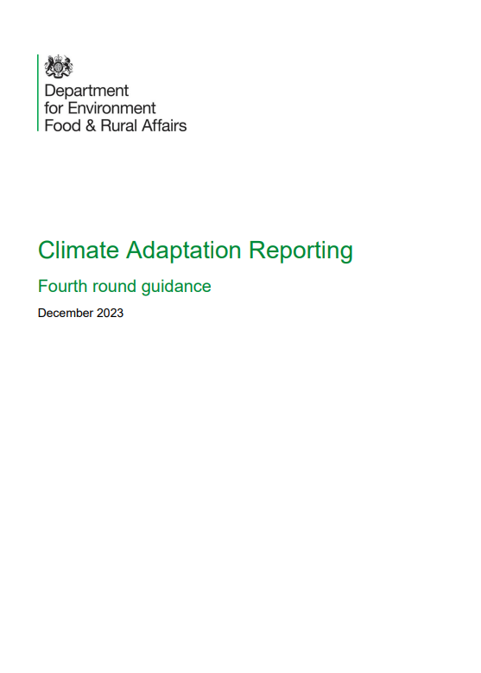
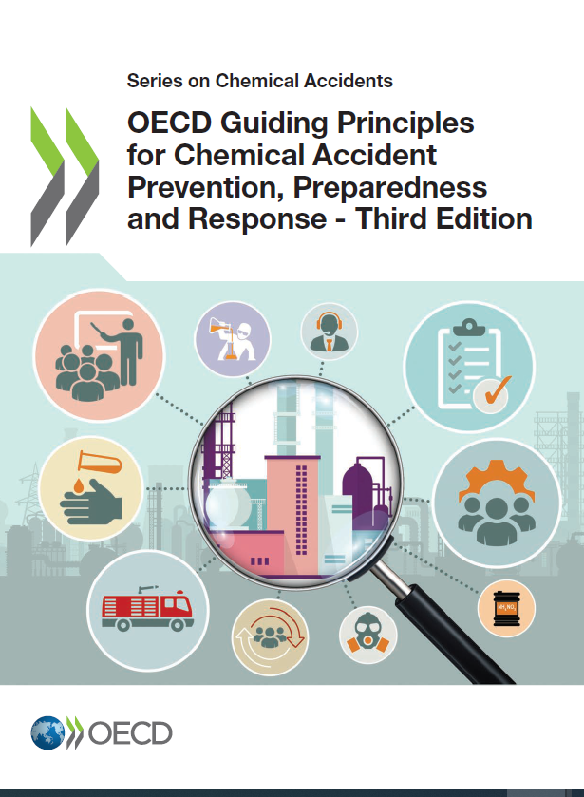
Where can I get more information?
Get started by considering and, where appropriate, implementing EPR guidance
Develop a management system: environmental permits - GOV.UK (www.gov.uk)
Climate change: risk assessment and adaptation planning in your management system - GOV.UK (www.gov.uk)
  (See section “A changing climate” )
Adapting to climate change: industry sector examples for your risk assessment - GOV.UK (www.gov.uk)
Consider other relevant UK and international guidance, for example from DEFRA or from OECD
OECD (2023)
OECD (2022)

Slide 25
Where can I get more information?
Benchmark your risk assessment and control measures against guidance from CCPS, CIA, MAHB
Talk to your regulator and collaborate locally – there are many resources and networks available, eg,
  Adaptation Scotland
  London Climate Partnership
  Yorkshire and Humber Climate Commission
  Sustainability West Midlands
CCPS (2020)
CIA (2021)
MAHB (2020)

Slide 26
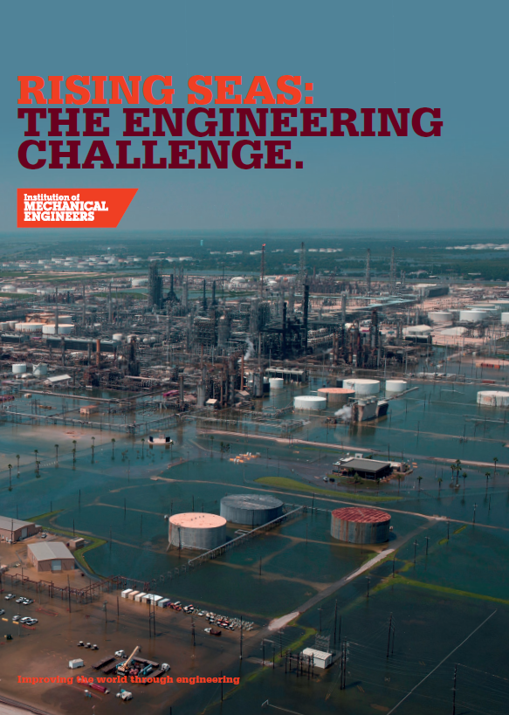
Where can I get more information?
IEMA (2022)
JRC (2018)
IMechE (2019)
IEMA CC Adaptation Practitioner guide and IMechE heat impacts and rising seas reports
Various EC Natech publications at MINERVA . e.g. JRC reports
  Natech risk management
  Understanding Natech risk due to storms
Sharing lessons across sectors….
PSF Carmont train accident Learning Brief
And a couple of great TED talks from Alice Bows-Larkin and Vicki Arroyo
The knowledge base on Natechs and adaptation continues to evolve rapidly
JRC (2022)
IMechE (2023)

Slide 27

What work is ongoing?
Met Office Hadley Centre collaboration
  Continuing work on UKCPs. Renewed focus on outputs for industry.
Environment Agency - in collaboration with partners & industry
  Maintaining guidance, training strategy, materials and inspection guidance, including ongoing CA campaign and training (Started April 2023)
  Continuing collaboration, for example through CDOIF and the Infrastructure Operators Adaptation Forum (IOAF)
Continuing international Natech research to understand impacts, learn lessons and inform international policy (e.g. JRC)
Environmental and safety regulation has a crucial role in ensuring infrastructure resilience and mitigating the potential increase in industrial risks – especially ensuring resilience of net zero infrastructure
There is a synergy between mitigation and adaptation - there is a synergy between environmental protection, safety and resilience

Slide 28
In summary
The climate has changed and continues to change.
The need for climate change adaptation
Without adequate management, risks will increase, including process safety risks. There have already been many high profile industrial major accidents with natural causes we need to learn from.
Safety and environment regulators expect climate change adaptation to be embedded into management systems, to maintain control of major accident hazards.
This requires operators of high hazard sites to ensure:
Leadership, resource and competencies
Climate change risk assessment - assess for 4°C, plan for 2°C, and avoid lock-ins
Plan, monitor, record and review, with top management oversight………. …………delivering Continual Improvement
International standards, guidance and case studies are available to support this work.

Slide 29
A closer look at the major hazard management system cycle
Section 2

Slide 30
What is the major hazard management system cycle?
Applies the principle of continuous improvement to ensure there is adequate planning, monitoring, recording and reviewing, with top management oversight.
A process safety approach to adaptation
Climate change adaptation is embedded into management systems, to maintain control of major accident hazards.
Potential MAH due to a changing climate are identified, the risks from each are identified, control measures are designed and implemented at an appropriate time …
… and the actions taken are reviewed to assess whether further measures are necessary

Slide 31
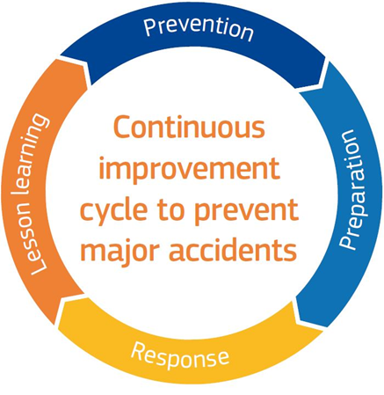
The COMAH principle of continuous improvement
Plan-Do-Check-Act

Slide 32
Adaptation & the major hazard management system cycle
Find control measures
ALARP demonstration
Adaptation plan (improvement plan)
Plan & implement improvements
Review and revise management system
Risk Assessment
Part A
Risk Assessment Part B
Gather specific relevant detailed data for Natechs
Sensitivity analysis
Risk trending /attribution
Risk evaluation
Monitoring, record and review actions
Monitor, record and review the adaptation plan
Monitor, record and review climate relevant data
Identify and appraise necessary risk reduction measures
Natech MAH risk analysis
Ensure top management oversight
Find potential impacts
Identify Natechs and other climate change impacts relevant to COMAH
Collate relevant data
Major hazard identification & evaluation procedure* inclusive of Natechs
Pre-planning & leadership
Policy, scope,
resources and competencies
Structure follows management system cycle and dovetails with ISO 14090 and 14001 and EPR guidance at gov.uk
All measures, including the management system, to be implemented proportionately to major accident hazard risks
Management
system (MS)
cycle of continuous improvement

Slide 33
Adaptation & the major hazard management system cycle
Find control measures
ALARP demonstration
Adaptation plan (improvement plan)
Plan & implement improvements
Review and revise management system
Risk Assessment
Part A
Risk Assessment Part B
Gather specific relevant detailed data for Natechs
Sensitivity analysis
Risk trending /attribution
Risk evaluation
Monitoring, record and review actions
Monitor, record and review the adaptation plan
Monitor, record and review climate relevant data
Identify and appraise necessary risk reduction measures
Natech MAH risk analysis
Ensure top management oversight
Find potential impacts
Identify Natechs and other climate change impacts relevant to COMAH
Collate relevant data
Major hazard identification & evaluation procedure* inclusive of Natechs
Pre-planning & leadership
Policy, scope,
resources and competencies
Key ISO 14090 clauses
Pre-planning
Assessing climate change impacts including opportunities
Adaptation planning
Implementation
Monitoring and evaluation
Reporting and communication
Management
System (MS)
cycle of continuous improvement

Slide 34

Pre-planning & leadership
What is the organisation’s adaptive capacity? i.e. The operator’s ability and resources to adjust to changes in the climate and weather
Pre-planning
Find potential impacts
Policy – demonstrating leadership of, commitment to, and accountability for implementing climate change adaptation management and to incorporate and embed climate change adaptation into its policies, strategies and plans for management of major accident hazards.
  Is there a commitment to adapt? What is the operator’s safety/adaptation culture?
  What ambition? - Enough to comply, or striving for Best Practice? A just transition?
Scope – clearly define scope of adaptation planning activities
  Limited to managing environmental/safety threats and risks, or to also include wider opportunities (e.g. planning for Net Zero transition/opportunities)?
  Just COMAH (major accidents), or also other purposes (EPR/PPC, CCA, planning, TCFD)?
  As part of wider business resilience planning?
  Consider adopting ISO 14090 within 14001 management system
Resources & competencies – ensuring organisational capability to carry out necessary work. Defines climate change skills and competencies required throughout the organisation and required resources, including top management commitment and finance. Climate change adaptation embedded throughout all roles and responsibilities so that emergent threats can be identified.
Risk Assessment
Part A
Risk Assessment Part B
Find control measures
Adaptation plan (improvement plan)
Monitoring, record and review actions

Slide 35
Find potential impacts
Screening / stress testing impacts associated with a 4°C rise by 2100
Pre-planning
Find potential impacts
Major hazard identification & evaluation procedure - Ensure Natechs, including weather threats and linked climate change impacts, are embedded in management system procedure for risk assessment (Hazard identification, analysis and evaluation) & management of change
  Consider ISO 14091 (assessing climate risks)
  Consider causation, degradation and escalation factors, plus data sources
  Define criteria with regards review/revision of risk assessments (including for new facts/knowledge)
Collate relevant data - Gather Natech relevant data, including:
  Existing Natech relevant major accident risk assessments, incident case studies (local and global), and local weather records and sector risks guidance (e.g. EPR guidance or sector reports, such as from Energy UK)
  Climate projections (UKCP18) of 4°C rise by 2100. Data sources include Met Office Derived Projections and the UK Climate Change Risk Assessment. Also, tools at UKCIP , UKCRP (e.g. Climate Risk Indicators) and the Environment Agency Climate Impacts Tool
  Other adaptation relevant data (land use planning info and financial assessments etc)
Identify Natechs (initiators and escalation mechanisms) - Identify and describe representative weather/climate change relevant Natech hazards & scenarios associated with a 4°C rise by 2100 scenario
  How could extreme weather initiate or exacerbate major accidents (MAs)?
  Could other climate change impacts initiate or exacerbate MAs? (e.g. rising sea level / increased vulnerability of receptors / geological impacts)
  Consider how climate change projections might increase / alter threats and risk at the establishment location over proposed installation lifecycle. A major accident scenario that is not credible today might become credible in the future.
Risk Assessment
Part A
Risk Assessment Part B
Find control measures
Adaptation plan (improvement plan)
Monitoring, record and review actions

Slide 36
Risk assessment – Part A
Pre-planning
Find potential impacts
For impacts identified as relevant for a 4°C rise, carry out more specific risk assessment for various scenarios (including: i) present day, ii) 2°C by 2050 and iii) 4°C by 2100) - The present-day scenario and info should be covered by current Natech risk assessment and the approach for this will inform how to undertake future scenario risk assessments.
Gather specific relevant detailed data for Natechs – Past, present and future* meteorological, flood & coastal risk, river flow (high/low), sea level, temperature, fire risk, geological data etc. Also, topographical, general arrangement, equipment data / design parameters / vulnerabilities, and site maps / general arrangement drawings relevant for weather relevant threats and climate change impacts.
Carry out Natech MAH risk analysis in accordance with MS procedure, linking vulnerability of equipment / procedures to extreme weather and other climate threats, paying attention to original design criteria, to determine if equipment remains within the safe operating envelope or if there is increasing risk of failure leading to increasing MAH risk (i.e. Natech analysis within process safety risk assessment).
Risk evaluation - Compare present day and potential future risk (people and environment) to tolerability criteria.
* For prediction under future climate scenarios, UKCP18 is currently the basis of good practice modelling with data available for different climate scenarios– see Met Office projections/predictions
Risk Assessment
Part A
Risk Assessment Part B
Find control measures
Adaptation plan (improvement plan)
Monitoring, record and review actions

Slide 37
Risk assessment – Part B
Pre-planning
Find potential impacts
Sensitivity analysis – Proportionate sensitivity analysis of the conservatism of the assessment; especially important where climate change influenced risks are high and risks may not remain tolerable in the future. Using data from a wider range of climate projections (2°C and 4°C, H++, RCPs 2.6, 4.5, 6.0 and 8.5, SSPs) can help build understanding of how climate impacts may change with different future scenarios and in turn what that might mean for establishment vulnerability and major accident risk
Risk trending/attribution - How does major accident risk correlate to the threat from predicted severe weather events/climate impacts (frequency and/or severity)?
  Have risks increased significantly from when the establishment was designed/built to present day?
  Are today’s risks tolerable (ALARP)?
  Are there dominant risks from specific weather events and/or plant areas where risk is changing more rapidly?
  Will risks remain ALARP in the near future – to the point of next risk assessment review?
  Will risks remain ALARP over the asset/installation/establishment lifetime? As with sensitivity analysis, exploring data for a range of climate projections can help build understanding of risk trends for any natural causes which pose or will pose a greater level of risk.
  Considering equipment design specifications and envelope of safety - What is current understanding of the predicted rate of change of risk over time? Will risks remain tolerable in the future or will the equipment design envelope be exceeded, increasing risk of failures and thus increasing MAH risk to become intolerable?
  Need to understand rate of change of risk in terms of any potential future risk reduction measure lead times.
Risk Assessment
Part A
Risk Assessment Part B
Find control measures
Adaptation plan (improvement plan)
Monitoring, record and review actions

Slide 38
Find control measures
Pre-planning
Find potential impacts
ALARP demonstration
If present day risk is not ALARP then identify and appraise further risk reduction measures to find those control measures that are reasonably practicable (including any necessary further data gathering and management systems revisions). Use safety and pollution control hierarchies to guide measures to control foreseeable natural causes.
If future risks may not remain ALARP due to changing weather threats/climate impacts, identify appropriate management/other measures to ensure risk will remain ALARP both until the next review point and over installation lifetime. For example:
  Ensure new designs incorporate flexibility/upgradability to allow risk reduction to be implemented in the future – e.g. when planning measures associated with 2°C by 2050, ensure actions or decisions do not create obstacles for future adaptation that may increase risk later (known as “lock-in”).
  Review existing measures associated with people, plant and processes and identify potential measures to improve resilience
  Ensure emergency plans will achieve their outcomes under foreseeable Natech conditions/events
Risk Assessment
Part A
Risk Assessment Part B
Find control measures
Adaptation plan (improvement plan)
Monitoring, record and review actions

Slide 39
Adaptation plan (Improvement plan)
Pre-planning
Find potential impacts
Risk Assessment
Part A
Plan & implement improvements - adoption and implementation of necessary measures required, at an appropriate time, to ensure major accident hazard risk is ALARP and in future will remain so. This to include planning to gather further info/data where there are gaps in knowledge.
  Consider an adaptation pathways approach (BS 8631)
  Develop performance indicators and climate impact indicators and identify key points/thresholds when substantial decisions need to be made with consequences or lead-in times >5 years (e.g. infrastructure, nature-based solutions, supply chain contracts) so that timely management decisions are ensured
Plan to audit, review and revise management system and plan to test emergency control measures through exercises - ensure the management system remains adequate for weather Natech and plan to test measures through Natech relevant emergency plan tests/exercises
  Plan to make any necessary change to ensure Natechs and adaptation are embedded within all aspects of the management system
Risk Assessment Part B
Find control measures
Adaptation plan (improvement plan)
Monitoring, record and review actions

Slide 40
Monitoring, record and review actions
Pre-planning
Find potential impacts
Monitor, record and review the adaptation plan including monitoring of indicators which both show the performance of the management system and adaptation plan and the evolution of climate impacts vs decision trigger points
Monitor, record and review climate relevant data - (including any changes to data/assumptions) near misses/incidents/data, both at the establishment and globally as relevant to the establishment (e.g. accident reports and weather data)
Identify any weather events/changes/MA knowledge that challenge existing risk assessment data/assumptions – consider any that are significant since they could trigger early review/revision (SR and RAs)
Ensure top management oversight and commitment and decisions regarding major accident risks - including audit and review outputs - including influence of climate change on safety at the establishment.
  Ensure Natechs and adaptation are embedded in process safety leadership
Risk Assessment
Part A
Risk Assessment Part B
Find control measures
Adaptation plan (improvement plan)
Monitoring, record and review actions

Slide 41
Major hazard management system cycle - summary
Pre-planning & leadership
Policy, scope,
resources and competencies
Find control measures
Adaptation plan (improvement plan)
Risk Assessment
Part A
Risk Assessment Part B
Monitoring, record and review actions
Find potential impacts
Record & review from stage to stage and iterate as necessary as progress is made…….
…………………but don’t get bogged down at one stage – top management should drive progress to meet the corporate goals for adaptation
ISO 14090 is designed to allow dipping in and out of sections. It is OK if the process is not neatly linear/cyclical, but there should be overall continual improvement.
The organisational approach should allow for identification and management of new Natech knowledge outwith the formal cycle.
Management
system (MS)
cycle of continuous improvement
Better to be nearly right than precisely wrong
Tim Reader

Slide 42
Natech case studies
Pt.1 – Accidents that have occurred
Section 3

Slide 43
What lessons can we learn from the past to make a safer, more resilient future?
Content
Flood – Coastal Acute Surge/Tsunami
Flood – Fluvial/river
High temperatures
Wind/storms
Lightning
Wildfires
Ice/cold
Geological impacts
The resilience of net zero technologies to climate change
Also, see the eNatech database and ARIA Natech and Climate Risks

Slide 44
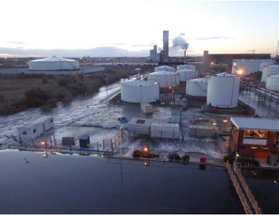

Flood – Coastal acute surge/ tsunami
See also “sea level rise”
Click to Return
to Slide 3
Tsunami - a long, high sea wave caused by an earthquake or other disturbance
Storm surge - an abnormal rise of water generated by a storm, over and above the predicted astronomical tides
Both a tsunami or storm surge can cause abnormal sea conditions, sea defence failure and can inundate industrial sites with flooding, all potentially causing catastrophic consequences. International examples include Fukushima where in 2011 inundation of a nuclear power station by a tsunami caused loss of power, loss of cooling and a subsequent nuclear accident. Lessons from Fukushima and other Natechs have been published by IChemE. More recently, the 2022 Tonga volcano eruption caused waves that triggered a “disastrous” oil spill in Peru and the refinery operator’s emergency preparedness was immediately criticised and hundreds of Peruvians donated hair to improvise absorbent booms.
In 2013, a UK East Coast surge caused failure of coastal defences at multiple locations. Fortunately, whilst there were no resultant COMAH major accidents, there was a severe threat to safety and significant business disruption and many lessons have been learned…
  Lessons learned from the coastal flooding of process industry sites on Teesside and Humberside by the storm surge on 5-6 December 2013 (icheme.org)
Another surge occurred in 2017 that resulted in more threats to industrial sites and more lessons captured in a Process Safety Forum Safety Alert.
In the UK, the risk of coastal flooding from storm surges and high tides will increase as sea levels rise.

Slide 45
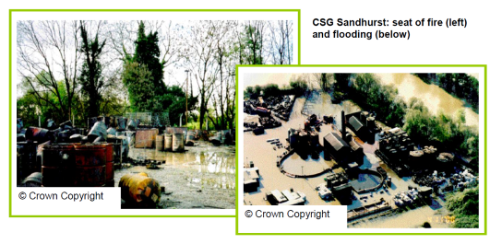
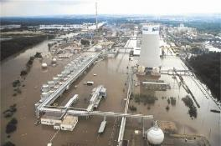
Flood – Fluvial/river
River (fluvial) flooding - A watercourse is a flowing body of water, including rivers, streams and brooks. During times of heavy rainfall, watercourses' capacity can be exceeded, resulting in flooding to land, infrastructure and homes. Rainfall intensity and flood extent/severity/frequency is expected to increase with the changing climate.
In 2002, flooding in the Czech Republic lifted liquid chlorine tanks, damaging pipework and releasing ~90 tonnes chlorine.
It is important to recognise that natural hazards can both cause and exacerbate accidents. In 2000, a fire occurred at a hazardous waste treatment facility and three days later the site was flooded. The flooding compounded problems faced during recovery. A report of the incident and its root causes is available as case study 2 in the free to download Environment Agency special issue of IChemE’s Loss Prevention Bulletin.
Also, historic dioxin contamination was flushed into the surrounding environment, so crops and fields were damaged or destroyed (IChemE LPB Issue 180, 2004).

Slide 46
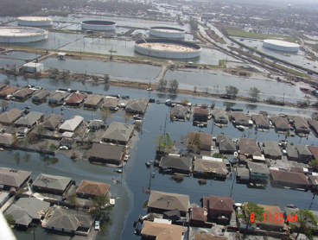
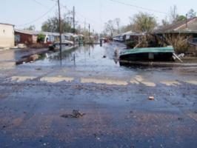
Flood – Fluvial/river
Flood waters can significantly alter drainage pathways, carrying pollution over wide areas to impact people, property and the environment. Risk assessments need to recognise the full effects of Natechs to inform adequate preventive and mitigatory measures. Further guidance on flood preparedness has been published by CDOIF and on gov.uk.
The Murphy oil spill (Hurricane Katrina, 2005) was caused when flood waters floated and buckled a large crude oil storage tank. Oil was released which contaminated people, properties and the environment and led to $330M damages.
Metalworking oil spill, Japan (2019)
As well as pollution, residents trapped upstairs by oil-covered flood waters reported nausea and skin irritation (Misuri et al.)

Slide 47
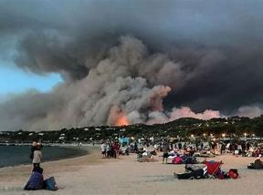
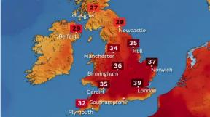
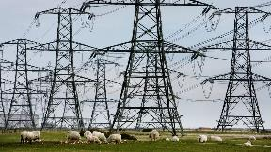
High temperatures
High temperatures and heatwaves can cause multiple issues for industry (IMechE has discussed these for people and processes) and aggravate hazardous industrial events. A common accident scenario is fire generated by the self-heating of materials or waste. To combat fires during extreme heat, significant water resources are required.
A report on climate extremes in the UK found that we are experiencing higher maximum temperatures and longer warm spells in recent years.
In July 2019, the phenomenon was seen in France impacting industrial activities. In Cote d’Or, a fire broke out in a capacitor bank of a food-processing plant which impacted 50% of the site's production capacity. Overheating of the capacitor banks due to exceptional heatwaves was determined as the cause of the fire.
Temperatures in the UK soared to the highest the country has ever seen during the heatwave in July 2022. Due to extreme heat, conductors sagged, and transformers were overheating, leaving approximately 8,000 properties in Yorkshire, Lincolnshire and Northeast without electricity. Heat-related impacts also affected Transport and Technology sectors, leading to significant disruption.
Industry impacts that occurred affected multiple sites with fire, explosion and other infrastructure/equipment failures. Lessons from high temperature events can be explored further in French case study material – Flash 2020, Report 2020 with experience from previous heatwaves e.g. 2015 and 2012.

Slide 48
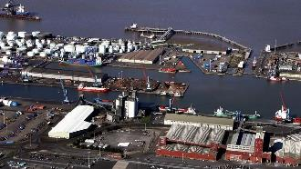
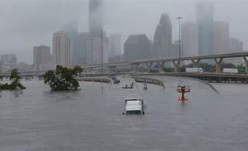
Wind/Storms
An increase in frequency and magnitude of storm events is possible in a changing climate in the UK, increasing threats to high hazard installations, during and when recovering from a storm. Whilst there remain uncertainties and research needs, CCC highlight that prudent planning today is vital. High windspeeds can exert strong forces on buildings, leading to damaged infrastructure, including to Net Zero solutions. Wind can carry objects that become dangerous projectiles. Furthermore, storms can cause tree fall and floods, damage power systems and lead to prolonged power outage, impacting critical infrastructure systems (including drainage & flood defence measures), causing cascading impacts and creating accessibility issues for emergency response/evacuation.
The Port of Immingham in the Humber Estuary, the UK’s largest port by tonnage, was impacted by high wind speeds causing a tidal surge which breached flood defences in December 2013. The terminal is located in a highly vulnerable flood zone. The storm surge cause a 5.1m AOD river level rise which overtopped the dock entrance and filled the estate, leaving the terminal inundated by 1m flood depth. The embanked protection failed, and electrical infrastructure was badly impacted. The terminal remained inoperable during immediate recovery. In March 2017, a £7.4m flood defence scheme works was approved.
Hurricane Harvey was a category 4 storm in Texas near Houston, USA in August 2017. Home to 500 industrial sites, it is a hub for the oil and chemical industry in the US. The hurricane wiped 25% off the US’ refining capacity and oil/natural gas production had to be shut down in Southern Texas. This was as a result of significant damages such as damaged storage tanks, broken pressure valves and 500 steel barrels tanks spilled oil and wastewater showing the tremendous impacts of natural and technological hazards on the environment and society. Storms bring a range of hazards – wind, flood and lightning – and unplanned shutdown/start-up risks .
See also Arkema and Biolab incident reports.

Slide 49
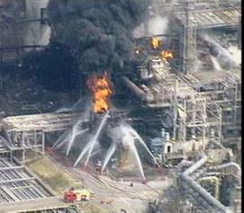
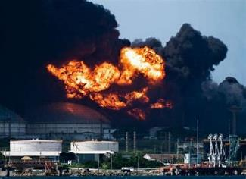
Lightning
Lightning is one of the most frequent Natech events, particularly tank fires. Infrastructure and equipment can be impacted directly by lightning strikes, such as pipes and connections, which can impact safety and electrical systems. This could lead to hazardous material releases or ignition of flammable vapours. Third party services (e.g. utilities/data) can also be impacted. There has been various research on whether climate change will cause lightning to increase or decrease, and whilst this presently remains an uncertainty there is growing evidence of increasing risk for UK.
An explosion and fires broke out at the Texaco Refinery, Milford Haven in Wales in July 1994 . This accident was triggered by a severe electrical storm that caused plant disturbances in the crude distillation unit where it was struck by lightning. The explosion was caused by failure of equipment and control systems that led to a malfunction in an outlet pipe. As a result, 20 tonnes of hydrocarbon liquid plus vapour found a source of ignition and subsequently exploded.
In August 2022, a lightning bolt struck a tank at a fuel depot in Havana, Cuba which led to a fire. This spread to a second tank, causing a blast and sent black fumes into the sky. Explosions could be heard by residents. The fire left 16 dead, 121 critically injured and 1900 people were evacuated. The impacts of the disaster was compounded by an outdated energy network and fuel shortages due to increases in demand for energy during severe summer heat.

Slide 50
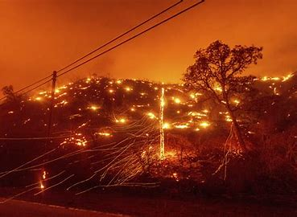

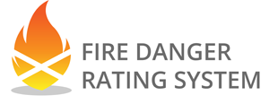
Wildfires
There are concerns about the future of industrial plant safety and installations due to the associated risks of climate change. The interactions between hazardous industry and wildfires can cause fires, explosions or toxic spills. Without protective measures, industrial sites can be harmed as a result of thermal radiation and direct flames.
Wildfires depend on ignition, fuel and weather conditions. Wildfires are more severe during extended periods of hot dry weather.
The Met Office's Fire Severity Index (FSI), for England and Wales is an assessment of how severe a fire could become if one were to start. However, it is not an assessment of the risk of wildfires occurring. This is used for fire prevention restrictions which aim to minimise accidental fires on access land vulnerable to wildfire.
The CZN Lightning Complex fire over California occurred in August 2020 due to a dry lightning storm that triggered wildfires in the Santa Cruz mountains. Benzene, a carcinogen, had been detected in the water supply due to melting of infrastructural pipes releasing plastic.
Scottish Fire Danger Rating System provides similar mapping of fuel types in habitats that could lead to wildfires for Scotland.

Slide 51
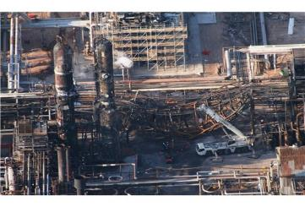
Ice/cold
Periods of cold weather are characterised by low temperatures, sometimes combined with snowfall and/or wind. This often leads to high electricity consumption, and subsequent technical incidents. They are often the cause of power failures, disruption to telecommunication networks and a range of on-site infrastructure damage (e.g. freezing pipes or collapsing roofs). Due to a changing climate in the UK, cold days are expected to be less frequent and milder which may reduce risk. However, some have observed that this could lead to a reduction in experience responding to cold weather events and thus less effective response should it occur.
A lack of freeze protection measures was not completed in a control station of the Sunray Valero Refinery, USA. In February 2007, water in propane accumulated at the bottom of a pipe. The pipe cracked due to freezing and expansion of water but remained sealed due to ice. When temperatures increased, the ice in the pipe melted, exposing the crack and releasing 2000 kg/min of liquid propane, which ignited. The refinery was forced to shut down.
A chlorine leak from a chemical packaging company in France in 2017 from its wastewater system. This caused shutdown of the site's automatic treatment plant. The UPS system, supplying electrical power to the plant, shut down following a period of extreme cold which caused the batteries to overheat. At a later date, heated cabinets were installed in the UPS system to protect it from freezing temperatures.
The CIA Guidance and update note on winterisation provide good information on managing process plant through severe and prolonged cold weather.

Slide 52
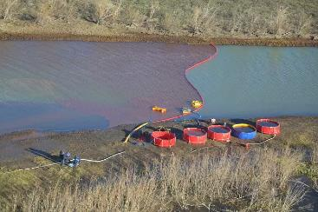
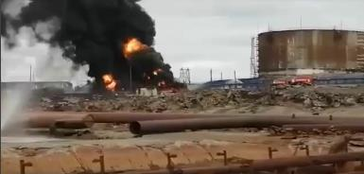
Geological impacts
Norilsk oil spill (2020) : Up to 17,500 tonnes of diesel spilled on to the ground and into local rivers. It is understood there was a combination of causal factors, including corrosion of tank bottom and collapse of foundations due to permafrost melting. The incident could cost the company over $2bn. Root causes will lie in the management system and leadership culture.
Not all climate change impacts are linked to acute extreme weather events. The evolution of climate and weather patterns over longer periods of time can have cascading and feedback impacts, including geological ones, which can threaten safety and environmental protection. Drought, sea level rise, subsidence, river/coastal erosion and landslips can all impact industrial sites.
Incidents and near misses in the UK have included: Severe riverbank erosion causing washout of a site roadway and threatening a large hydrocarbon storage tank; ground movement damage to underground pipes and services; cracked bunds and drainage systems. Accidents have also occurred outside the high hazard sector where common lessons can be learned : e.g. Carmont train accident

Slide 53
Do net zero technologies need to be resilient to climate change?
“The climate emergency and the global drive to Net Zero energy systems will require a rapid and seismic change in how energy is generated, stored, transmitted and used. Global energy policy is rapidly changing to incentivise or ensure the decarbonisation of energy systems. And at the same time, society must ensure tomorrow’s energy systems are resilient to tomorrow’s climate impacts – Energy security must both meet the challenges of Net Zero and account for the changing climate to ensure infrastructure resilience.” Climate Change Committee, 2022
Resilient net zero technologies
Technology that is key to achieve Net Zero such as renewable energy may be vulnerable to extreme climate and weather events.

Slide 54
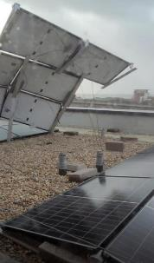
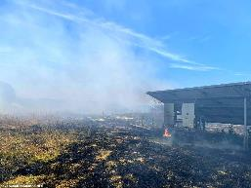
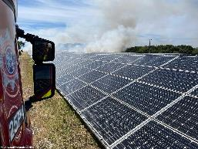
Solar
During Storm Eunice in February 2022, one of the worst storms in the UK in 30 years, solar panels were ripped off a building roof in Southampton close to where the storm gusts were at their highest. The panels served communal areas such as lighting and elevators for the building. As a result of the storm, they were severely damaged and out of use.
Panels in a solar farm in Dorset were damaged during a wildfire in the heatwave of July 2022. Twenty firefighters tackled a fire at the 113-acre solar farm for three hours which had 81,400 panels.

Slide 55
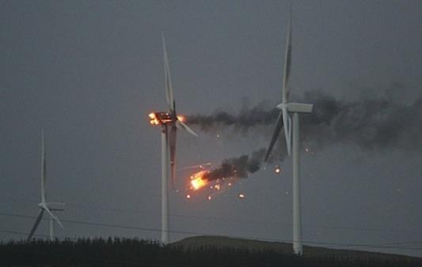
Wind power
The most common cause of wind turbine fires are lightning strikes, though fires are also caused through electrical and mechanical failures, including exacerbation by high ambient temperatures.
An Australian wind turbine farm contained 112 turbines. The entire farm was shut down during a heatwave when a turbine caught on fire, leaving 63,000 homes without power. Moreover, the turbine ignited ground fires which caused burning debris, destroying 80,000 hectares of a national park. The fire was found to be caused by an electrical failure in the nacelle.
Whilst industrial sites are frequently considered as ideal locations for solar/wind, the potential knock-on risks to the establishment from blade throw or other wind-blown debris needs to be accounted for in operators’ risk assessments.

Slide 56
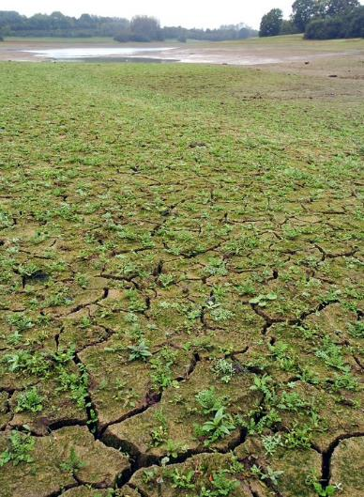
Other net zero approaches are also vulnerable
During prolonged dry weather or drought, techniques ranging from carbon capture and storage to tree planting can be impacted by reduced water availability.
Floods can impact any non-resilient infrastructure – for example, flooding can impact electrical systems, and there is growing evidence of extended fire risk from Li-Ion batteries exposed to salt water.
Reservoir in drought

Slide 57

“Creating a net zero nation resilient to climate change”

Slide 58
What are the possible failure modes from natural causes?
Water and wind barrier failures/degradation
  Flooding
  Heavy rain
  Strong winds and storms
  Sea level rise
Low temperature barrier failures/degradation
  Heavy snowfall
  Ice and prolonged cold
High temperature barrier failures/degradation
  High temperature and heat wave
  Prolonged dry weather and drought
Other barrier failures/degradation
  Lightning
  Hail
  Geological impacts

Slide 59
How can natural hazards impact safety and environmental protection?
Possible barrier failures/degradation (1)
Flooding
  Floating of vessels or impact damage to equipment, causing loss of containment (potential multiple losses)
  Loss of power/utilities/control and communication systems
  Compromising secondary/tertiary containment and drainage integrity/functionality
  Hampering emergency response due to unavailable resources or access/egress issues
Heavy rain
  Sinking of floating tank roofs
  Exacerbation the consequences of spills by providing a medium for the dispersion of the released substances
  Compromising secondary containment capacity
Strong winds/storms
  Structural damage either directly or due to wind-blown debris
  Access restrictions hampering emergency response
  Wide area power/communications systems loss
Sea level rise
  Increased risk of local sea/estuary defences failing and sites flooding
  Increased forces on jetties/coastal structures due to changes in marine/estuarine currents

Slide 60
How can natural hazards impact safety and environmental protection?
Possible barrier failures/degradation (2)
Heavy snowfall
  Access restrictions hampering process operation/maintenance
  Weight on structures causing structural collapse/loss of containment
  Loss of power/utilities/control and communication systems
  Compromising secondary/tertiary containment and drainage integrity/functionality
  Flooding impacts following thaw
  Hampering emergency response due to unavailable resources or access/egress issues
Ice/prolonged cold
  Freezing of process pipework causing no /low flow and associated scenarios,
  Causing potential pipework damage and subsequent loss of containment upon thaw
  Instrumentation faults and malfunctions leading to loss of process control
  Metal fatigue/other equipment damage causing failures and malfunctions
  Access issues or freezing of firefighting systems impacting emergency response

Slide 61
How can natural hazards impact safety and environmental protection?
Possible barrier failures/degradation (3)
High temperature/heat wave
  Insufficient process cooling, particularly where using ambient air as coolant
  Impact on workforce/reduced human performance
  Process equipment/instrumentation overheating and malfunctioning,
  Increased risk that systems may not be available when required, eg sprinkler system frangible bulb failures meaning the sprinkler system is not available on demand
  Increased fire risk/material decomposition/ material auto-ignition
  Increased wildfire risk (either direct impact to establishment or indirect impacts – utilities/emergency response)
Prolonged dry weather/drought
  Impact on cooling water or fire water availability
  Increased vulnerability of environmental receptors
  Subsidence/ground movement impacting on equipment supports and containment system integrity

Slide 62
How can natural hazards impact safety and environmental protection?
Possible barrier failures/degradation (4)
Lightning
  Ignition of fires at or near the installation
  Damage to equipment, in particular, electrical and control systems
  Wide area power/communications loss
Hail
  Direct impact hazard to people, plant and processes
  Loss of power/utilities/control and communication systems
Geological impacts
  Impact to foundations with possible catastrophic failure consequences
  Erosion of river/coast leading to impacts to infrastructure at or around the establishment
  Damage to underground infrastructure, including drains and utilities
  Cracking of containment systems

Slide 63
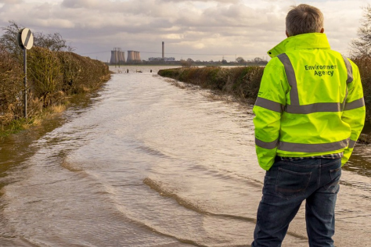
Climate impacts on industrial installations
For more, sector-specific examples of how climate impacts can affect industrial installations, see:
Adapting to climate change: industry sector examples for your risk assessment
And
Impact of Climate Change on Risk and Resilience of COMAH establishments
Click to Return
to Slide 3

Slide 64
Natech case studies
Pt.2 – Lessons learned
Section 3 continued

Slide 65
What lessons have we learned from the past, and how do we make a safer, more resilient future?
Content
Core principles
Introduction to hierarchy of controls
Key messages on lessons learned
Importance of learning lessons
Lessons learned about the impacts of climate change
EA Natech research
Control of accidents caused by Natech

Slide 66

Core principles
We have already seen incidents and the effects of being underprepared for climate change impacts.
So, now what?
We need to learn from these accidents – we need to continually improve to avoid harming lives, and impacting the environment and property
Change stems from and is enabled by the management systems
And remember the inherent safety principle (as Trevor Kletz reminded us frequently)
The safety and pollution hierarchies should be used to guide the choice of measures…

Slide 67
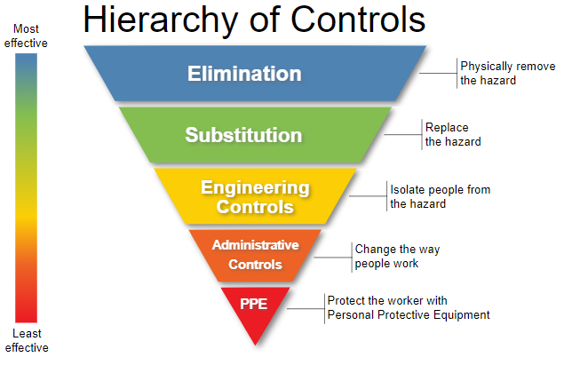
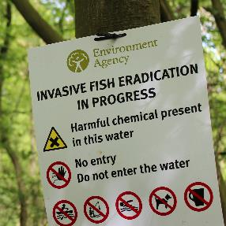
Introduction to hierarchy of controls
What you don't have, you can't leak (Kletz)
The safety hierarchy
Simply removing the hazard - replacing it with something that is not as much of a hazard or locating away from the from where it could cause harm.
Isolate people from the hazard. The capital costs of these are usually higher than less effective control, but may reduce future costs.
Procedure changes, employee training, installation of signs and labels. Limit and prevent exposure to hazards.
Notes:
Top two in hierarchy
+ For example, the propane fire in Texas, 2007. Reviewing the incident it was clear no consideration of inherent safety was part of it. Containers used chlorine in the cooling tower, but there are less toxic, safer options available. A chlorine leak could have worsened the incident by a lot.
Engineering controls
+ This might even look like building a good work platform rather than buying and maintaining fall arrest equipment
Administrative controls
+ Like doing road construction at night when fewer people are around.

Slide 68
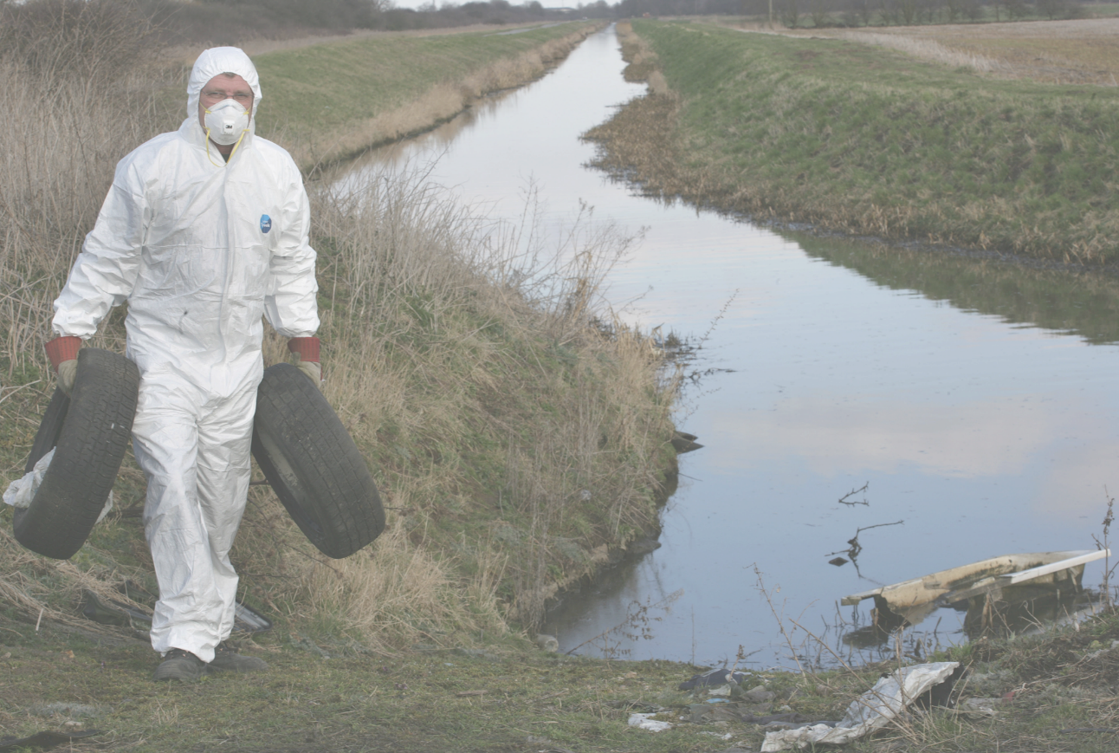
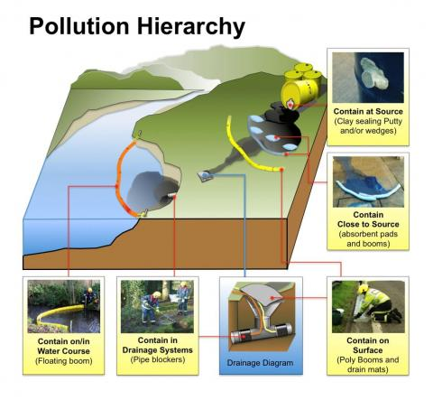
Hierarchy of controls

Slide 69
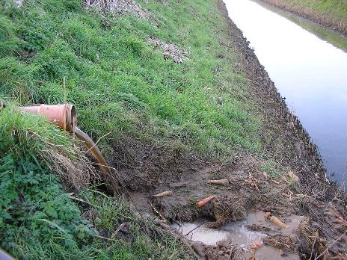
Hierarchy of controls – contain at source
Most effective. Stop pollutant at source/point of release, e.g. seal vessel, turning mobile containers so hole is upwards, stem the flow, decant into temporary vessel, close valves.

Slide 70

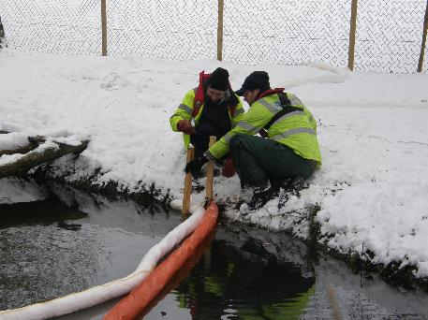
Hierarchy of controls – contain close to source
Contain the spillage as close to source as possible. Using equipment such as sorbents, or absorbents.

Slide 71
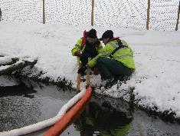
Hierarchy of controls – contain in drainage system
In the very plausible case that the pollutant gets into the drainage system, there is a need to contain within the system itself before it is further distributed.

Slide 72
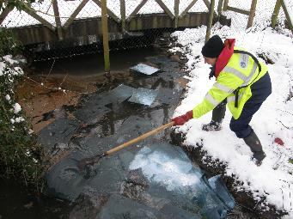
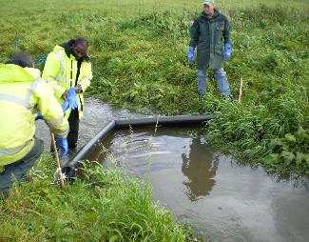
Hierarchy of controls – contain in watercource
Deployment downstream of incident can prevent/mitigate spread of pollutants less dense.
If pollutant mixes and or is denser than water, then damming is taken on.

Slide 73
Hierarchy of controls ...
In some Natechs, like flood, none of these options may be available and risk reduction needs to focus on measures at the top of the safety hierarchy: Elimination, substitution and engineering controls for primary containment.
Deployment downstream of incident can prevent/mitigate spread of pollutants less dense.
If pollutant mixes and or is denser than water, then damming is taken on.

Slide 74
Key messages on learning lessons
How to use these principles and hierarchies?
What kind of measures to take?
core ideas and lessons from other sites
Action needed now to implement preventions, don’t wait for natech to occur
“Following an accident, I used to say to people who’ve had an accident ‘don’t write a report, I’ve got it on file already’,” - Trevor Kletz
There is a wealth of Natech case studies to learn from

Slide 75
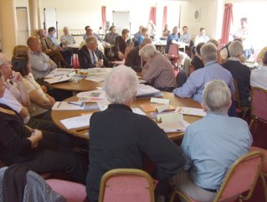
Importance of leaning lessons
The greater principle is simply learning from our mistakes, learning lessons.
Risk assessment sector examples – being updated to capture learning from early implementation and lessons from 2022 (due spring 2023).
2022 was the warmest on record for UK and brought intense heat, drought and severe storm impacts
“Accidents are not caused by lack of knowledge, but by a failure to use the knowledge that is available”.
Trevor Kletz

Slide 76
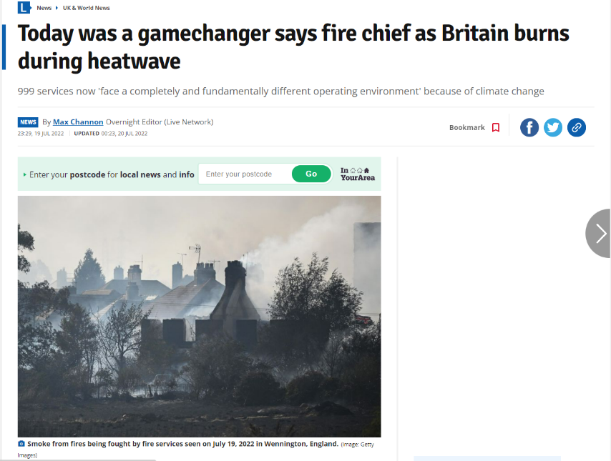
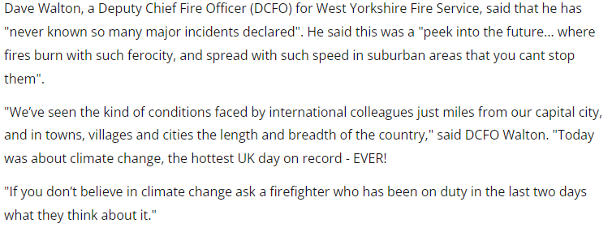
Lessons learned about impacts of a changing climate
Have emergency plans included extreme Natech scenarios? And have these been tested through operator/multi-agency exercises?

Slide 77

Chances of seeing 40°C in the UK under a high emission scenario
Notes:
This past summer we reached highs of 40 and above. Recent articles have touched on how the Met Office and full temp data for 2022 shows there was an average temperature increase of 10.03C, highest since 1884. 15 of the UK's top 20 warmest years have all occurred this century.
Medium emissions – sort of where we are right now. But still 1 in 15 years, so still a huge difference.

Slide 78


Lessons learned from extreme temperatures
Higher probability of a vast range of issues: over pressurisation, spontaneous combustion, overheating, melting/UV degradation of containers/pipework
Hot temperatures shown to exacerbate many risks to do with fires and explosions
Caused placement and exposure of equipment and waste to become very important
Key lessons centred around management of placement of infrastructure, and flaws in design of internal systems
Wildfires
  Management and monitoring of vegetation at the boundaries around site
  Management of the storage of explosives and substances posing fire risk
    How long unused/rejected substances are to be kept on site
    Level of shade and protection from direct sunlight and extreme heat
Drought
  Fires, runaway compounded by drought and strong winds
  Increased understanding and improvement of integrated water usage and recycling systems
  2004 fire spread through several industrial facilities. Encouraged by ongoing drought, and a strong wind
Notes:
With the frequency and severity of heatwaves increasing rapidly, we do not have long to change how we manage our plants and prevent the same disasters from occurring again.
With more intense heat comes higher probability of …
Hot temperatures have been shown to exacerbate many risks to do with fires, explosions
This has caused ideas about placement and exposure of equipment and waste to become very important.
Key lessons learned I have picked up are centred around management of placement of infrastructure, and mistakes in design of internal systems.
Wildfires
2011 heat wave instigated brush fire, igniting explosives kept on site in direct sunlight
Drought
2019 fire in composting centre from fermentation phase. Runaway compounded by drought and strong winds.
Increased understanding and improvement of integrated 0water usage and recycling systems
2004 fire spread through several industrial facilities. Encouraged by ongoing drought, and a strong wind.

Slide 79


Lessons learned from extreme temperatures
Waste fires/scrapheap fires:
  Management of wastes, e.g.
    Oily rags
    Broken and discarded batteries or engines
  Electric batteries risks
    Thermal runaway
    Requires more water for extinguishing fire
  Site management and housekeeping
Over pressurisation
  Disastrous chain explosions instigated on a day with temperature of 36°C, well within range of 2022
  Heat raised temperature and pressure of gas cylinders
  Incorrectly setup gas venting and pressure relief systems allowed for gas to unnecessarily vent during hot weather. Heated up nearby cylinders, and chain reaction allowed for spreading of fire
    Understanding of temperature on pressure levels and thus the inbuilt systems
    Understanding of relief systems, and constant testing and review of how they operate

Slide 80


Lessons learned from storms
Storms pose a unique threat with various simultaneous impacts in combination – wind, rain/hail/snow, lightning, flood
Recent storms have revealed a need to change how we design structures
Key lessons learned:
  severe underestimation of flood risks showing the inadequacy of existing barriers
  designs of roofs and structures being unable to cope with the increasing wind loads (made worse by ageing assets)

Slide 81

Lessons learned from storms
Lightning
  Ignition of flammable substances
    Management of wastes
    Gases, e.g. biogas at AD sites
    Vessels, e.g. tanks or cylinders
Flooding
  Floating of tanks, bunds
    Implementation of guide rails, and connecting walkways to tanks at risk of flooding
    Monitoring of substance levels in vessels
  Increased conductivity for lightning throughout site
Wind
  Weather membranes
    Reinforcement straps
    Monitoring of joints and seam strength
  Tall structures

Slide 82



Environment Agency
Natech research
In 2022 an Environment Agency IChemE intern researched past and recent Natechs.
A spreadsheet was developed to break down the incidents, broadly categorising the lessons learned. This has informed revisions of Environment Agency guidance.
In terms of lessons, the most common learnings featured at Design and planning stage - neglecting to consider climate change impacts from early stages of site location and design, or reviews of continuing adequacy of design, has contributed to many incidents.
Also, failings in Emergency Response Plans and policies and testing and maintenance were frequently identified.
All failings could have been easily improved, all fall under existing management system approaches.
Need implementation of training and an appreciation of how climate change can capitalise on weaknesses in standard management systems.
The agencies are training officers on Natechs, climate change adaptation and links to management system controls – operators similarly need to develop these capabilities.
Notes:
Example of case study and how I sectioned my research. Left is summary of what I found when attempting to categorise roughly the “types” of lessons learned across the board.
Constructing and researching for this project, I assessed a lot of case studies from the past and recent years.
I created a spreadsheet to keep track and to break down the incidents, broadly categorising the lessons learned that I extracted.
I have attempted to categorise different types of lessons learned and what broad category they could fall under.
Then, I have tried to count up the different lessons learned across the board, out of interest..
Design stage comes highest, suggesting that implementing our climate change adaptation from early stages would indeed make a big different.
ERPs and policies came closely behind,
Testing and maintenance also came in quite high.
These are all easily improved and all fall under management systems and how it is designed from the start. If training and an appreciation for these sections and how climate change can capitalise on weaknesses here can be implemented into standard mgmnt systems, then it would be little work for large reward.

Slide 83
Control of accidents caused by Natech
Natech risk can be effectively controlled by ensuring adequate management systems (root causes) that embed natural causes and climate change impacts
The greatest opportunity to reduce Natech risk occurs at the installation planning & design stage
Most management system aspects are important (but especially emergency planning and inspection/maintenance)
Adequately understanding Natech risk is fundamental
  Generally – no new lessons!
Historic accident review (hindsight)
Natech risk assessment (foresight)
Technical basis for "All Measures Necessary" *
The extent to which risk reduction measures are adopted then depends on corporate choices – influenced by the operator's culture and safety leadership approach (and the regulator's oversight and actions)

Slide 84
Adaptation action in practice – cross sector examples
The reporting information supports both national policy (e.g. the National Adaptation Programme and Climate Change Risk Assessment) and enables analysis of practical measures that can be taken to adapt.
The UK Adaptation Inventory documents adaptation on the ground, presenting a selection of sectoral adaptation options, based on national reporting to government by public and private sector organisations and a systematic review of peer reviewed literature.
https://www.nismod.ac.uk/openclim/adaptation_inventory
Under the Climate Change Act certain organisations produced reports on:
the current and future predicted effects of climate change on their organisation
their proposals for adapting to climate change
These reports outline good and best practices in adaptation across government and operators of key infrastructure.

Slide 85
Final thoughts
In theory,
COMAH, environmental permitting (and associated land use planning) can effectively control Natech risk to people and the environment…
But only if…
Natural causes and climate change impacts, today and in the future, are embedded throughout the management system to inform operator’s decisions and emergency planning.

